Slide 1


FIT.KOVAI HACKATHON-PRELIMS

Slide 2
STUDENT TEAM NOMINATION:
Title | Details
Team Name | Team Adept
Team SPOC | Jeevananth.P 2nd year Department of Computer Science and Engineering jeevananth.p2021csea@sece.ac.in 9566830591
Team Members | 1)ArulKarthi.P 2nd year Department of CSE arulkarthi.p2021csea@sece.ac.in 6380288138 2)Aarthi.N 2nd year Department of CSE aarthi.n2021csea@sece.ac.in 9360721162
3)Jeevavarshin.D
2nd year
Department of CSE
jeevavarshini.d2021csea@sece.ac.in
9361676041

Slide 3

PROBLEM SATEMENT
Music recommendation based on mood detection
Mood/Emotion can be through voice or facial expression or a combination

Slide 4

ABSTRACT:
Python based program to detect human emotions and
recommend songs according to the mood.
This program uses python modules like OpenCV and DeepFace
module which detects emotions,race and gender of people.
Finally, we use WebBrowser module to open the link for suggested songs.

Slide 5

SOLUTION:
We find plenty of applications which recommends songs if we search for it manually.
But we provide a best solution than existing is by suggesting songs based on users emotions by detecting their face.
Our system will detect the user’s face emotions on screen and predict the moods with the help of Deepface module and webbrowser module in Machine Learning.
Deepface module is the one which is used to compare each frames with several number of facial emotions datasets and detects the emotions.
Whereas Webbrowser module is used to link the of the music app.

Slide 6

ASSUMPTIONS:
Let us assume that the user will face the screen and waits for the music to recommend
The Cascade class in the CV2 module tracks the face of the user and the deepface module is used to analyze the face of the user and detects the emotion.

Slide 7
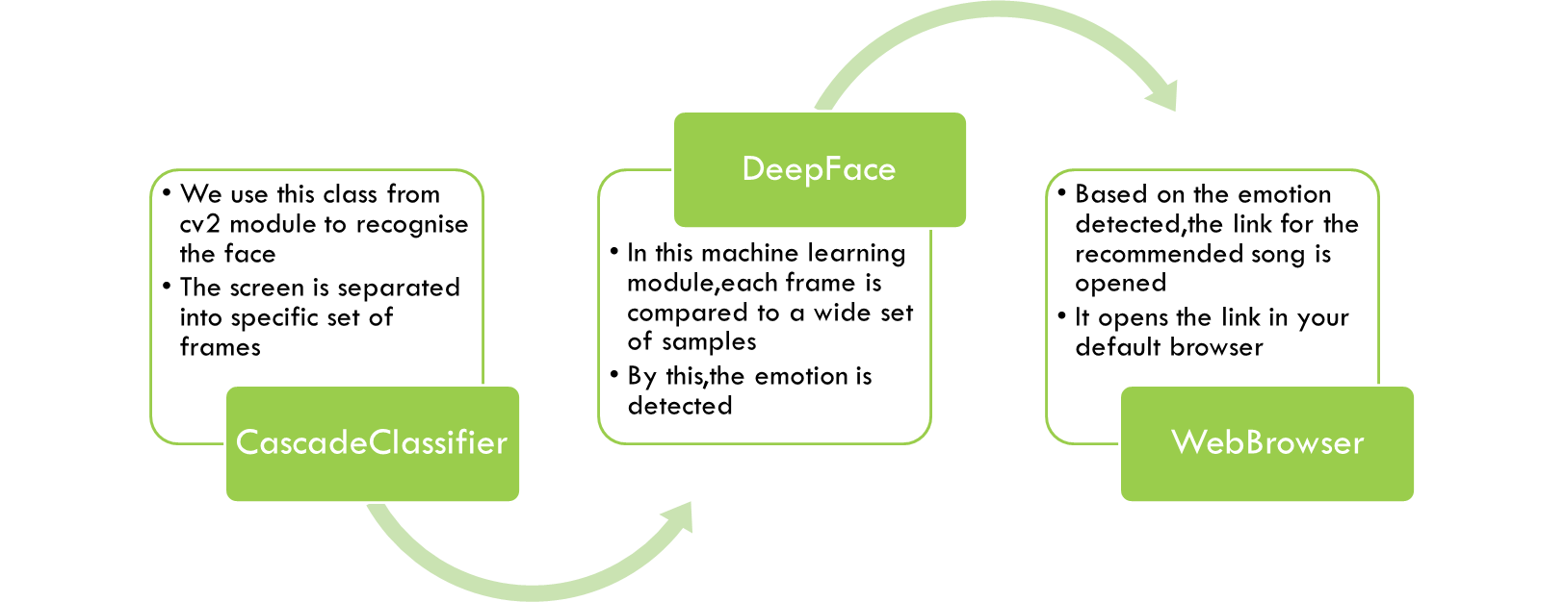
DESIGNS:

Slide 8
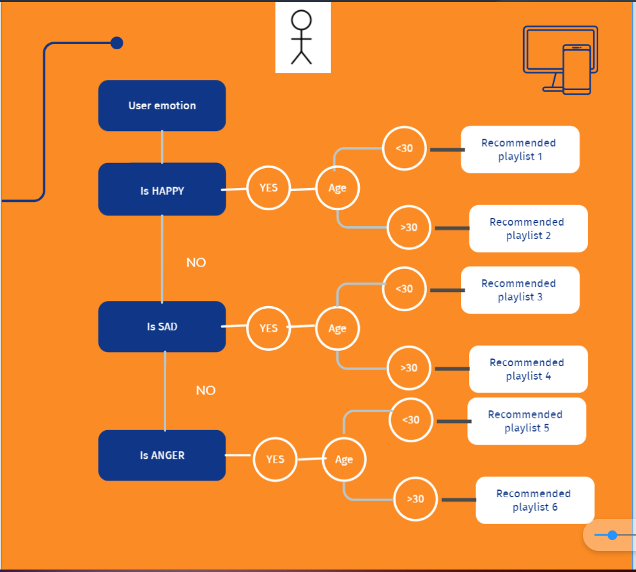
Working:

Slide 9
TEAM'S COMPETENCE:
We encourage each other’s efforts and contributions.
Everyone in the team actively participates in the work by taking on different roles and responsibilities.
We are efficient in problem solving and constantly listen to each other.
We have the ability to improve our performance through experience and development of individuals and the team.

Slide 10

PRIOR EXPERIENCE:
Has done a Face Recognition project using python for Mini Project.
Has done several other projects for the college.

Slide 11

SUMMARY:
Our project will be very user friendly for the users rather then the existing one in our upcoming generations.
Our project will automatically suggest songs based on the emotions, which makes the user to be stress free / happy.

Slide 12

Thank you
--Jeevananth P
--Arulkarthi P
--Aarthi N
--Jeevavarshini D

